Slide 1
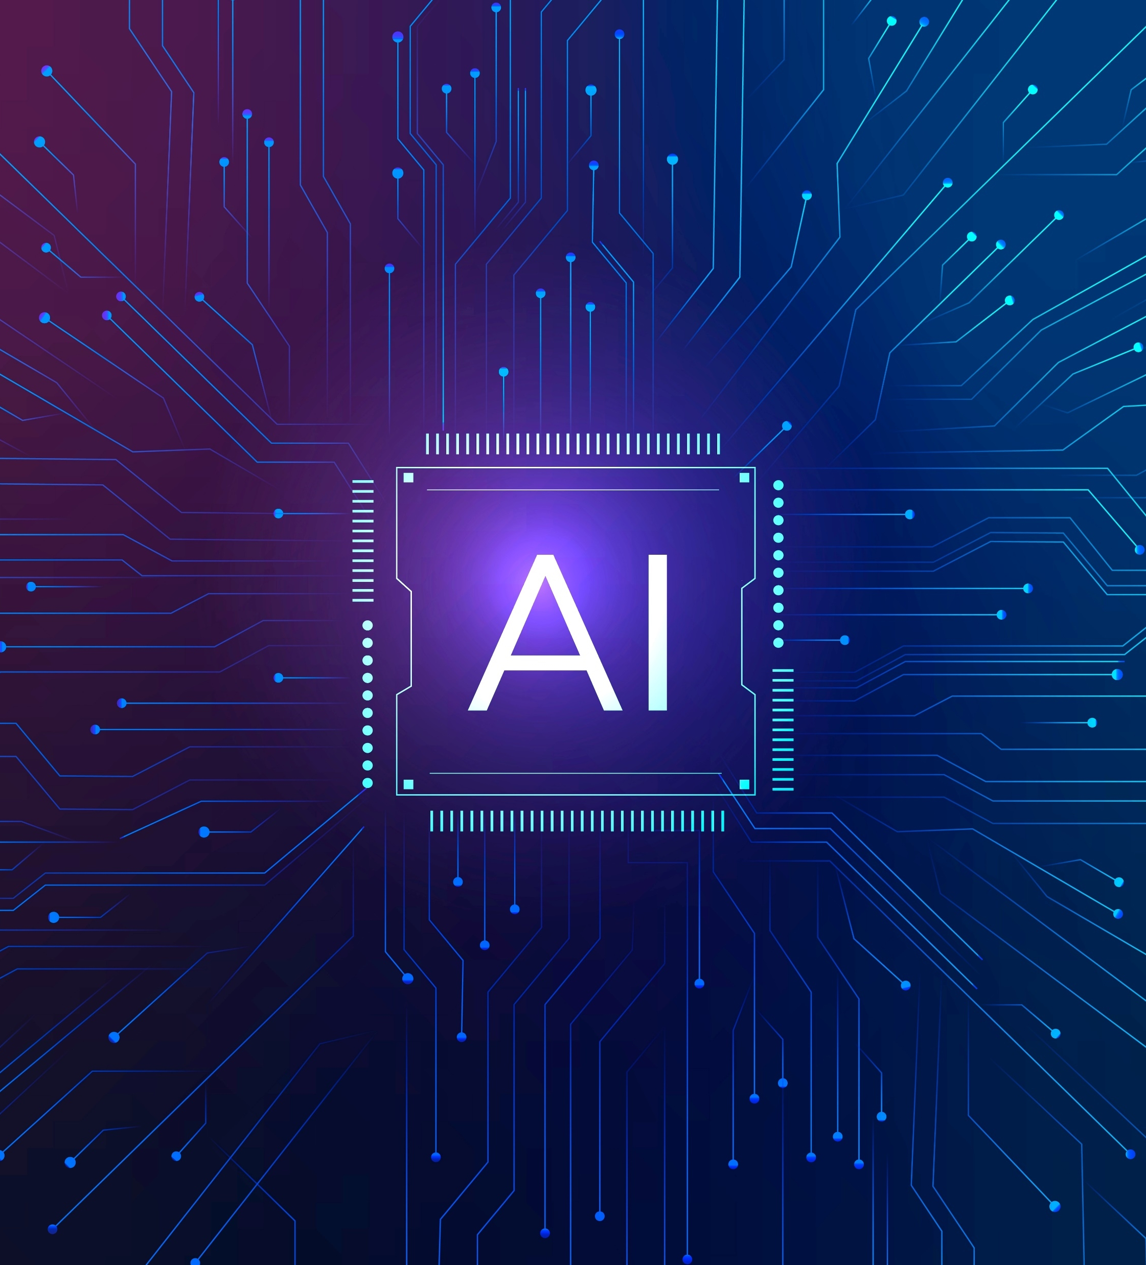
Accelerate Generative AI adoption with Custom RAG App on Azure

Slide 2
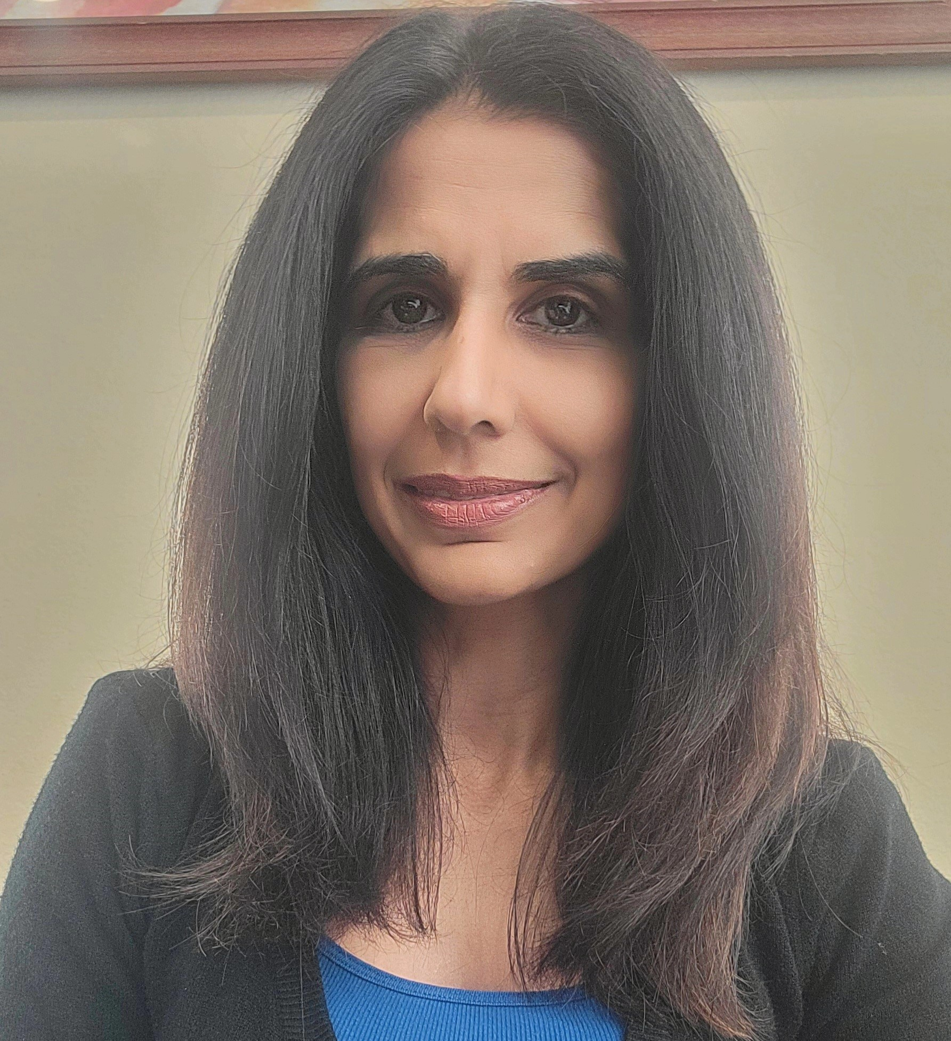
About me
Formerly:
Data Scientist in Defense, Healthcare industries
Arpita Parmar
Sr. Azure AI/ML Consultant at Microsoft

Slide 3
Today we’ll discuss
10 Minutes
RAG: Retrieval Augmented Generation
RAG options in Azure
15 Minutes
Demo: RAG Chat app solution: Information Assistant
20 Minutes
Technical deep dive into Information Assistant
5 Minutes
Q&A

Slide 4
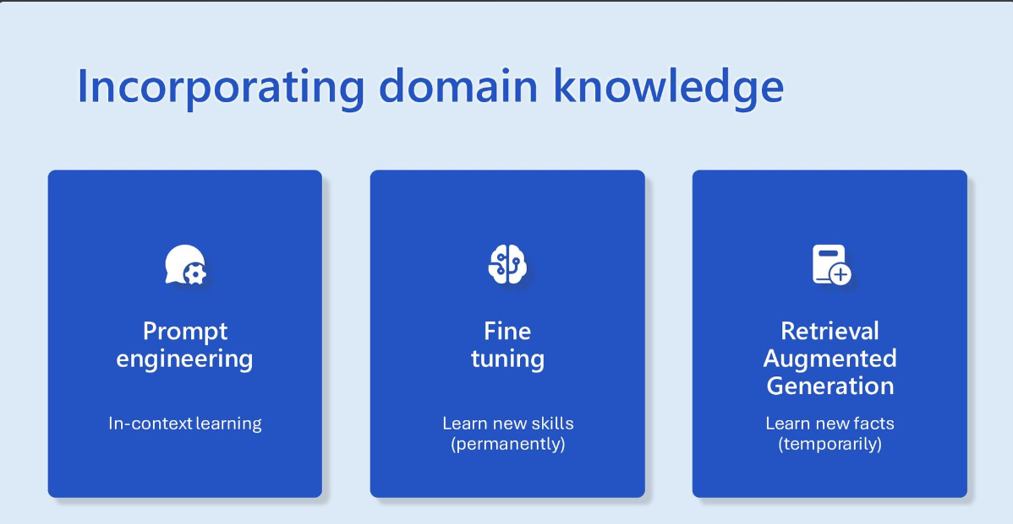

Slide 5
RAG patterns - AI Office Hours: Catch up on core concepts

Slide 6
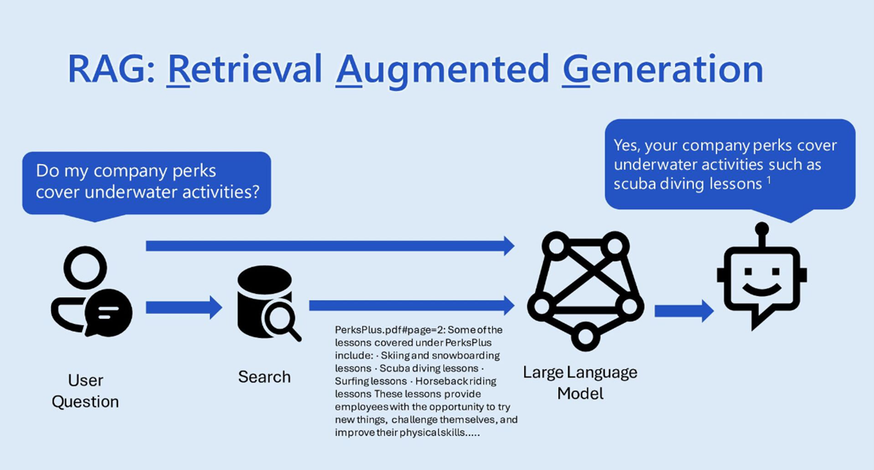
Azure OpenAI on your data
Receive user prompt.
Determine relevant content and intent of the prompt.
Query the search index with that content and intent.
Insert search result chunk into the Azure OpenAI prompt, along with system message and user prompt.
Send entire prompt to Azure OpenAI.
Return response and data reference (if any) to the user.

Slide 7
Create Azure Open AI Resource
Azure Open AI Studio – Azure Gov
Azure AI Foundry – Azure Commercial

Slide 8
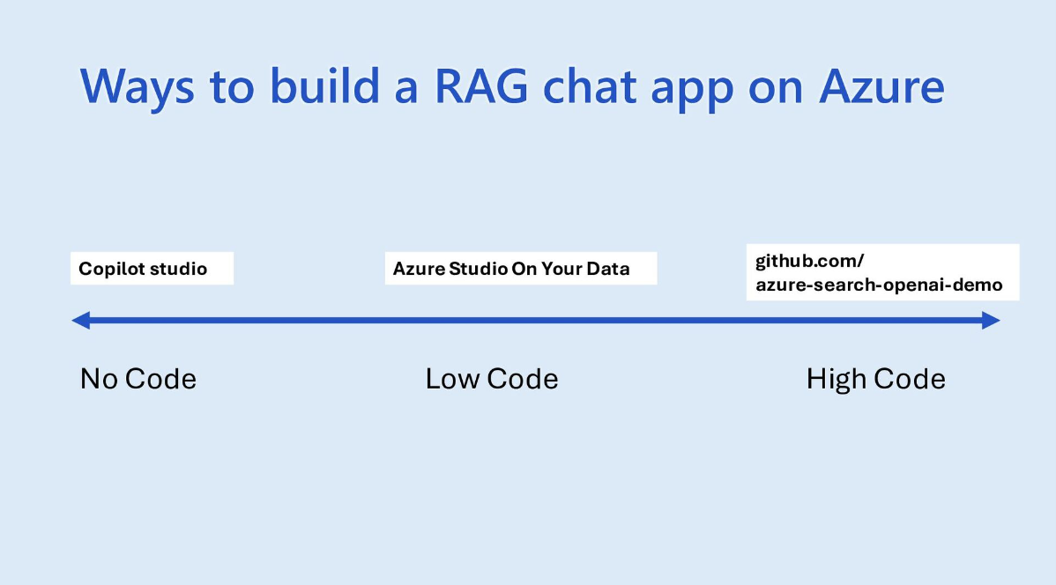
Copilot
https://github.com/microsoft/PubSec-Info-Assistant
Copilot Studio
Azure Open AI Studio

Slide 9
Create Azure Open AI Resource
Create Azure Open AI resource
Deploy Model
Use Chat Playground
Add your own data source
Chat with your Model using your own data

Slide 10
Lab Homework
How to set up environment:
https://github.com/Azure/azure-openai-samples/tree/main/quick_start
Make Azure Open AI API Calls using Python SDK:
https://github.com/Azure/azure-openai-samples/blob/main/quick_start/v1/02_ChatCompletion_api.ipynb
Use API version: 2024-05-01-preview for exercises

Slide 11
Env file for Lab
https://github.com/Azure/azure-openai-samples/blob/main/quick_start/v1/.env.sample
AZURE_OPENAI_ENDPOINT=https://<your service name>.openai.azure.com/
AZURE_OPENAI_KEY=xxxxxxxxxxxxxxxxxxxxxxxx
AZURE_OPENAI_DEPLOYMENT_NAME=gpt-4o
EMBEDDING_MODEL_NAME=text-embedding-ada-002

Slide 12
Requirement file for Lab
https://github.com/Azure/azure-openai-samples/blob/main/requirements.txt
Do not use versions for
python-dotenv
openai

Slide 13
Q & A

